Slide 1
Intro to Unsupervised Learning
Principles of ML & Deep Learning - SAILea
Ananya Raghu and Anisha Raghu

Slide 2
Unsupervised Learning
Unsupervised learning: uses unlabeled data, discovers “structure” or underlying patterns in data
AI that uses machine learning to analyze unlabeled data and cluster them
Identify hidden patterns, population/sample behaviors
Help determine relationships
K Means clustering is one of the simplest and most popular unsupervised learning algorithms
Notes:
Anisha

Slide 3
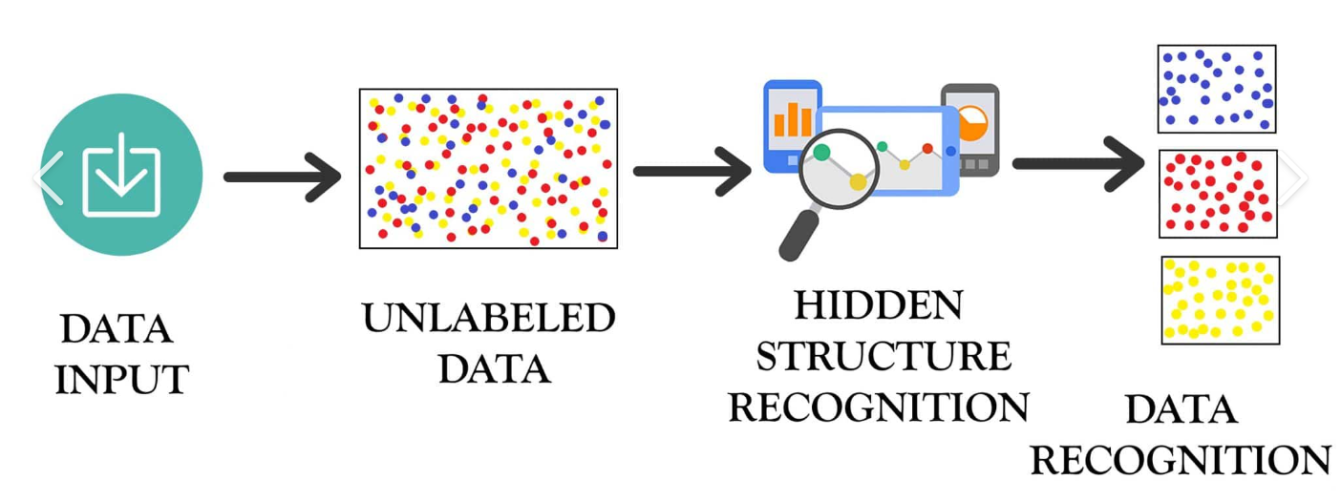
Notes:
Anisha

Slide 4
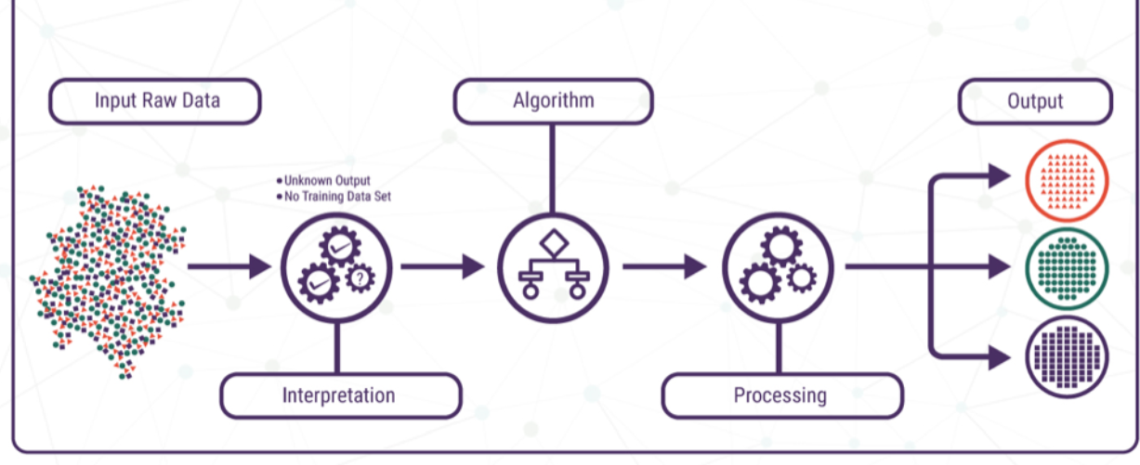
Notes:
Ananya (just add on) +PCA

Slide 5
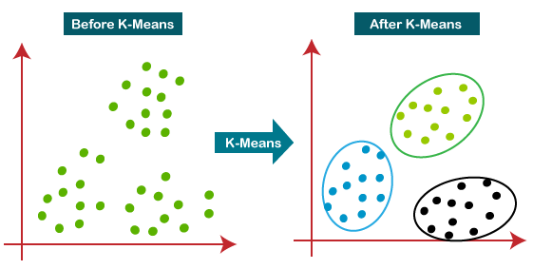
K Means Clustering
K means clustering works by clustering data points into groups
Centroid: location of center of cluster (doesn’t have to be a data point) → can specify number of cluster centers you want
Notes:
Ananya

Slide 6
The Algorithm
Step 1: Randomly initialize k cluster centroids
Step 2: Categorize each point as part of the cluster whose centroid it is closest to.
Step 3: Update the mean coordinates after all points per cluster are assigned
Step 4: Repeat the process for a certain number of iterations → have clusters at end
Notes:
Anisha

Slide 7
Source

Slide 8
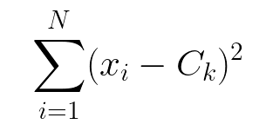
Concept of Inertia
Inertia is a measurement of how well a dataset responds to K-means clustering
Measuring the distance between each data point and its centroid, squaring this distance, and summing these squares across one cluster.
Ideally: low Inertia, and a small amount of clusters
The extreme case is to have zero inertia → but this means that every SINGLE point is its own cluster!
Tradeoff between minimizing inertia and having a low amount of clusters
To find the ideal number of clusters we can use the ELBOW method
Notes:
Ananya

Slide 9
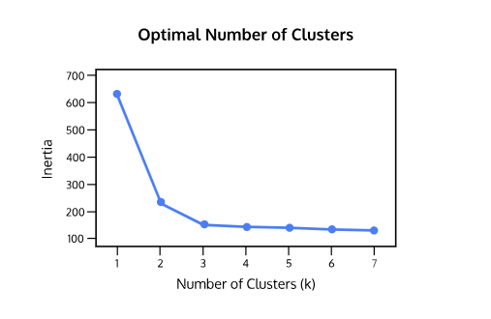
Elbow Method
To find the optimal number of clusters we can look for the elbow point in this graph to the right: where the rate of decrease in Inertia begins to slow down
Not much of an improvement after this “elbow” point
In the graph to the right this is K=3.
Source
Notes:
Anisha

